Slide 1
Real-Time Myocardial Infarction(MI) Prediction from 1D ECG data using Apache Kafka and Apache Spark
Submitted By: Ayemon Baraka
NSHE ID: 2002163212

Slide 2
Introduction
Heart attack is the number one leading cause of the death for men and women in the US.
Real-time heart attack prediction system can save many lives eradicating the limitation of current detection schemes.
The objective of this project is to develop a real-time system that can predict the likelihood of a person experiencing a Myocardial Infarction (one kind of heart attack) using big data tools and machine learning.
By analyzing the person’s ECG data in real-time, the system aims to provide early warnings to healthcare professionals, allowing them to take prompt action and provide better medical care to potentially prevent or reduce the severity of heart attacks.
The dataset used for this project contains 1D ECG data.
The goal of this project is to utilize Kafka to stream data from a CSV file to Spark, where the machine learning model performed real-time predictions.

Slide 3
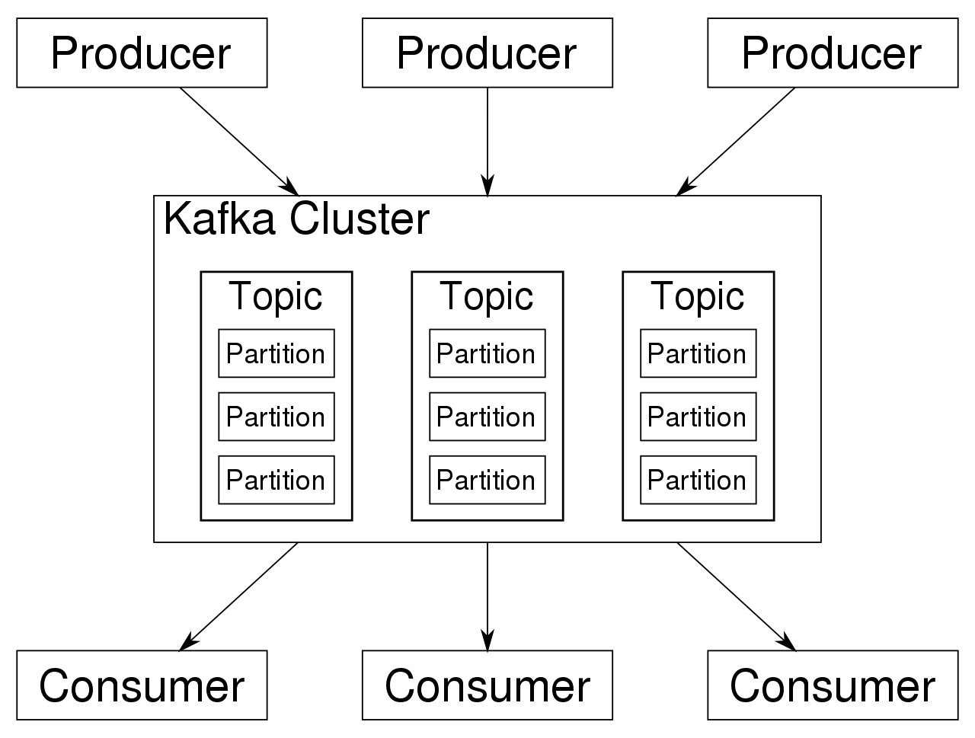
Overview of Apache Kafka
Apache Kafka is a distributed streaming platform that enables the building of real-time data pipelines and streaming applications.
It is designed to handle high-throughput, fault-tolerant, and scalable data streams. Key components of Kafka include:
Topic: A stream of data records, which acts as a channel for data transmission.
Producer: An application that publishes messages to Kafka topics.
Consumer: An application that reads data from Kafka topics.
Broker: The central unit of a Kafka cluster, responsible for storing and managing streams of records.
Zookeeper: Manages distributed coordination between Kafka brokers.

Slide 4

Setup Apache Kafka
Prerequisites: The prerequisites required for setting up Apache Kafka
Java JDK 8 or later.
Running instance of ZooKeeper.
Downloading Kafka:
The Apache Kafka website (https://kafka.apache.org/downloads)

Slide 5
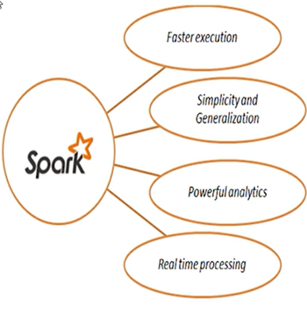
Overview of Apache Spark
Apache Spark is an open-source, distributed data processing engine designed for speed, ease of use, and advanced analytics. Key features of Spark include:
Resilient Distributed Datasets (RDDs): Fault-tolerant, distributed collections of data that can be processed in parallel.
DataFrames: Structured data representation, offering optimization opportunities.
Spark SQL: Enables querying structured data using SQL queries.
Spark Streaming: Allows processing of real-time data streams.
MLlib: Spark's machine learning library, offering various algorithms and utilities for building ML models.

Slide 6
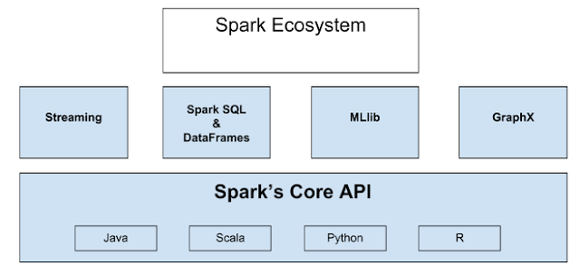

Slide 7
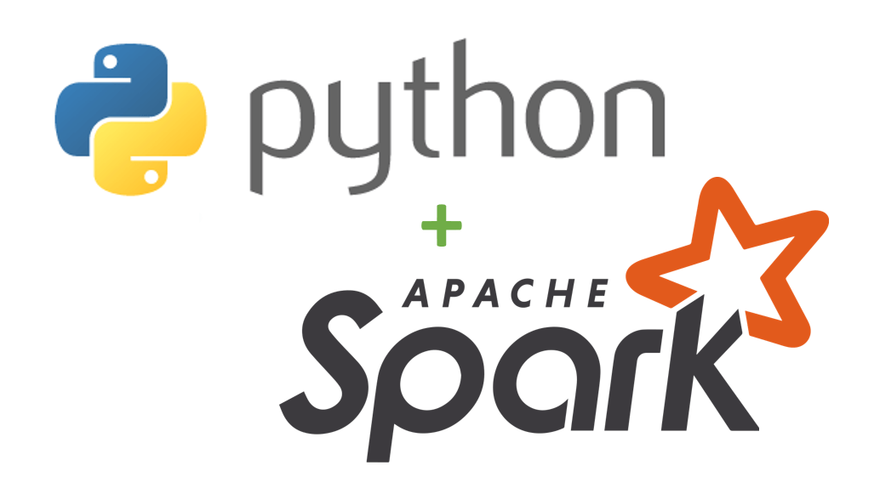
Setup Apache Spark and PySpark
Downloading Apache Spark:
Apache Spark website (https://spark.apache.org/downloads.html).
Setting Up Spark Environment:
Setting the ‘SPARK_HOME’ environmental variable to the installation directory
Adding Spark’s ‘bin’ directory to my system’s ‘PATH’ to easily access Spark’s command
PySpark:
The Python API for Apache Spark.
Installing PySpark:
pip install pyspark

Slide 8
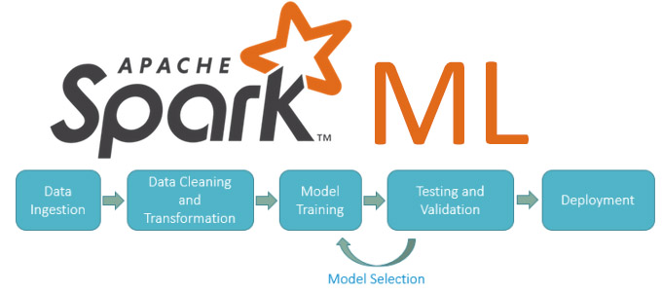
Spark Machine Learning Model
In this project, Spark's Mllib has been utilized to build a machine learning model for MI prediction.
The dataset has been loaded into Spark, and it has been split into training and testing sets.
Several machine learning algorithms have been explored, and finally logistic regression has been used to classify the dataset.
Logistic regression is a straightforward yet effective approach for this task, making it a suitable choice for predicting MI based on the provided data.

Slide 9
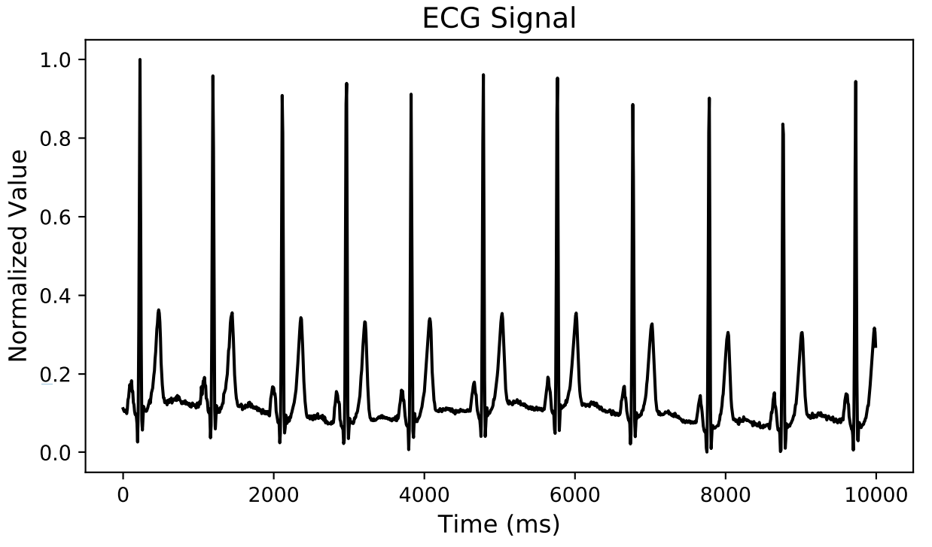
Dataset
The PTB Diagnostics dataset consists of ECG records from 290 subjects.
This dataset is open source and freely available on Kaggle. The link to the dataset is
https://www.kaggle.com/datasets/shayanfazeli/heartbeat
The data has been preprocessed to
handle missing values
all the samples have been cropped, downsampled and padded with zeroes to make its length equal to a predefined fixed length.

Slide 10
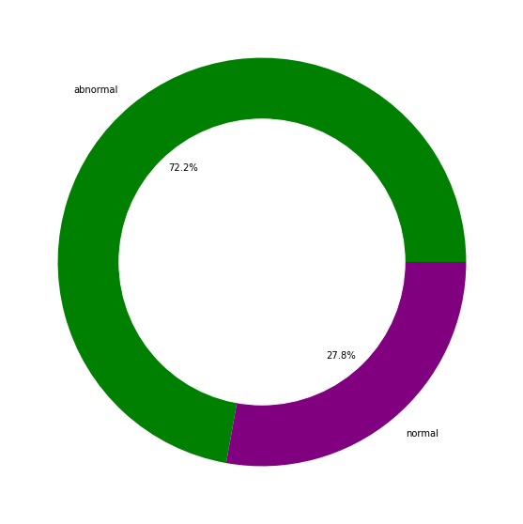
Dataset(Cont.)
In the dataset
Number of Samples: 14552.
Number of Categories: 2.
Sampling Frequency: 125Hz.
Data Source: Physionet's PTB Diagnostic Database.
148 diagnosed as MI , 52 healthy control, and the rest are diagnosed with 7 different disease.
Each record contains ECG signals from 12 leads sampled at the frequency of 1000Hz.
In this study we have only used ECG lead II and worked with MI and healthy control categories in our analyses.

Slide 11
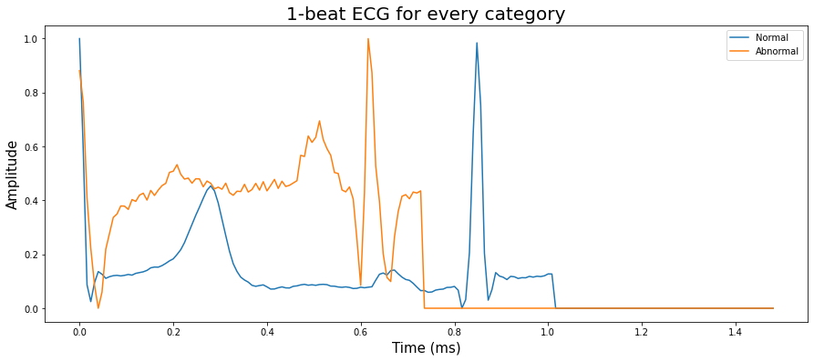

Slide 12
The architecture of heart attack prediction system
Building the offline model
Logistic regression, a classification algorithm, has been used for classification
Evaluation method is accuracy
Streaming processing pipeline
Data have been collected from two csv file (one contains normal ecg and the other one contains abnormal ecg) and sent to two Kafka Topic
Topic 1: ecg_normal.
Topic 2: ecg_abnormal
After that, Spark has read the streaming data from the two Kafka Topic.
Online prediction
The developed model has received the data and predicted whether the data contains indications of MI or not.

Slide 13
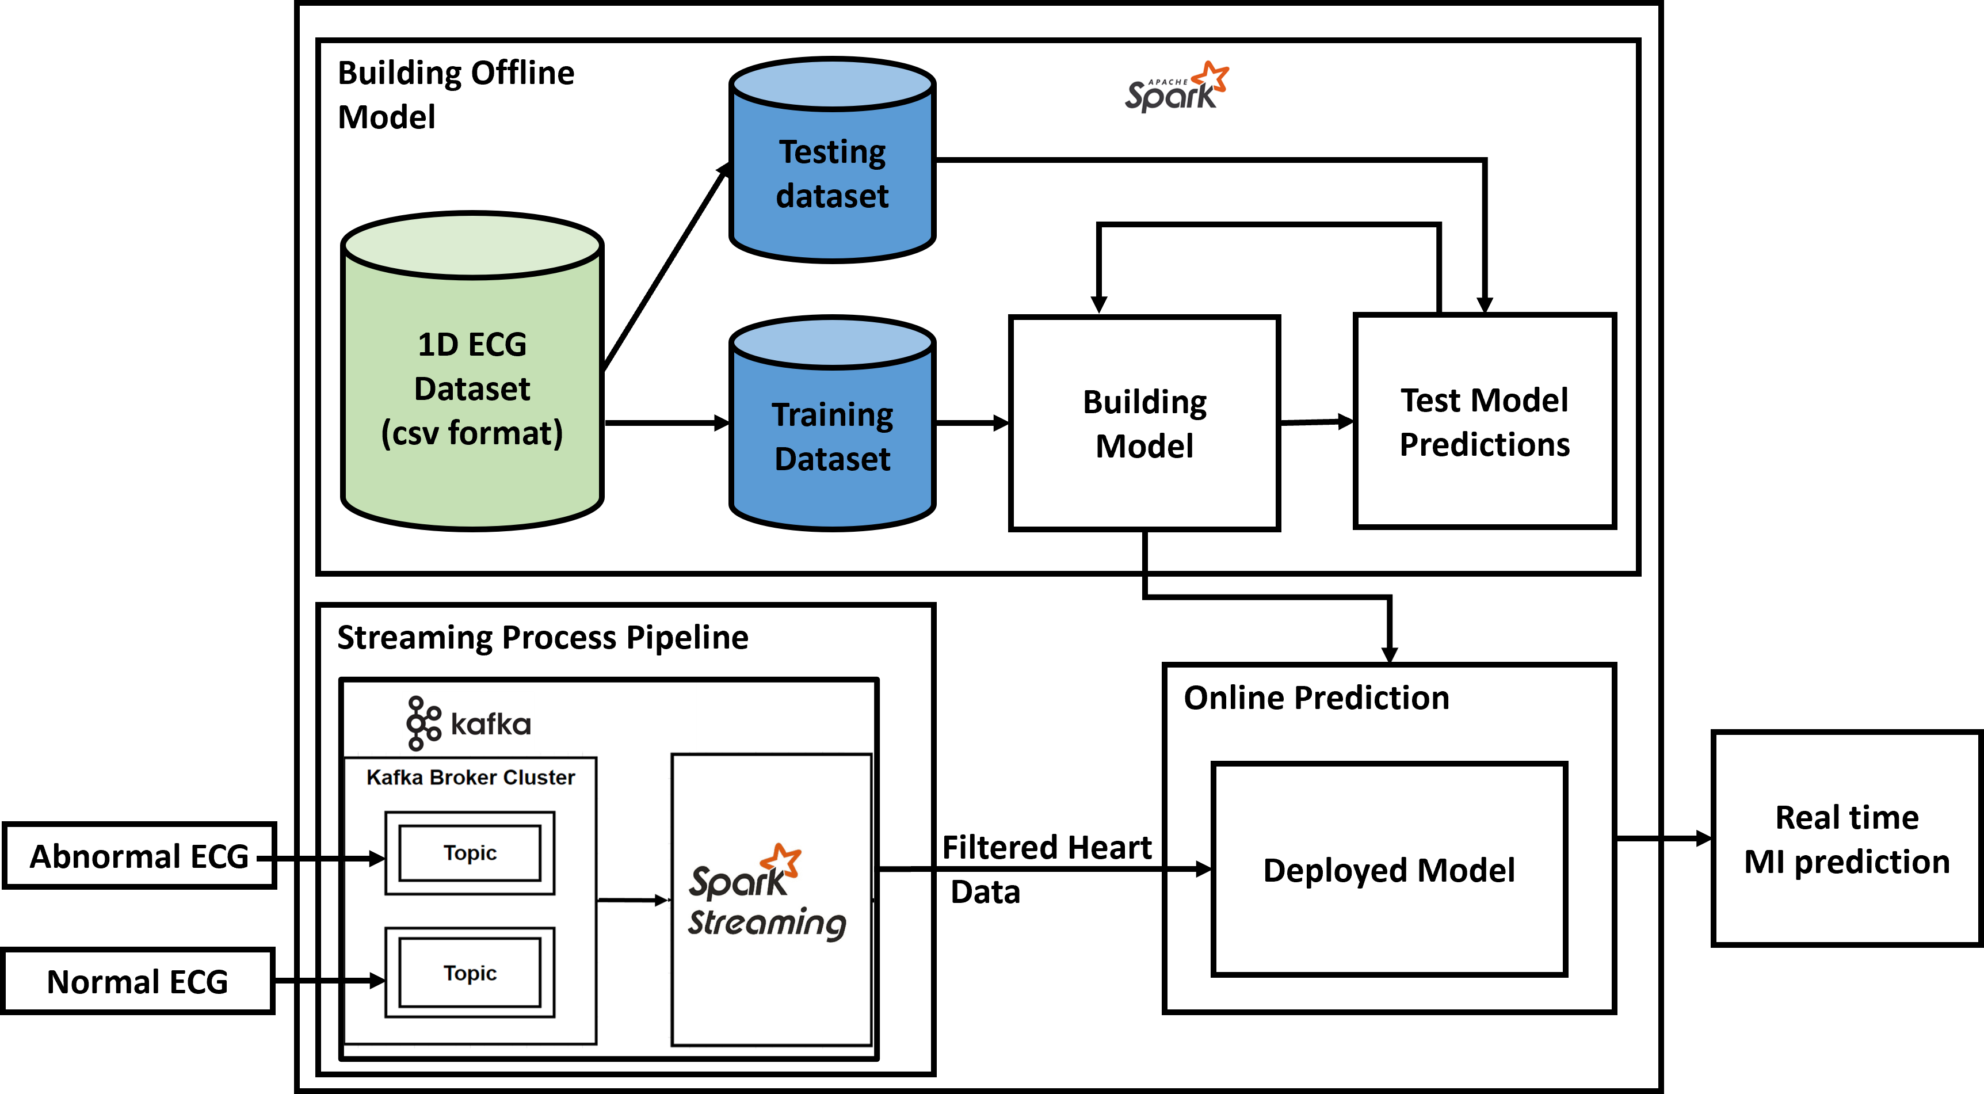
The architecture of heart attack prediction system

Slide 14
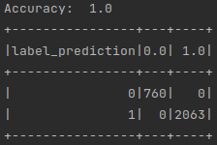
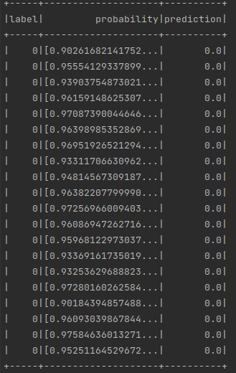
Model Generation and Storage Layer:
The data has been loaded form CSV file into a DataFrame.
A pipeline has been created, consists of three stages.
Vector assembler
MinMaxScalar
Logistic Regression Model
Logistic Regression has been used for binary classification with following parameters:
maxIter = 1
regParam = 0.1
Accuracy of the model is 100%

Slide 15
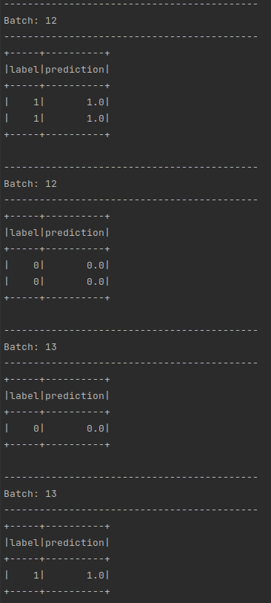
Real-Time Prediction
Kafka Producer:
The two CSV file containing the 1D ECG data has been used as a Kafka producer.
It has sent individual records (rows) of data to a Kafka topic at regular intervals, simulating real-time data ingestion.
Kafka Consumer (Spark Streaming):
Spark Streaming has been used as a Kafka consumer to receive data from the Kafka topic. Spark has maintained a continuous stream of data, allowing real-time processing.
Feature Extraction:
Each incoming record from Kafka has been preprocessed in Spark to align with the training data's format,
Real-Time Prediction:
The preprocessed data has been then fed into the pre-trained machine learning model.
The model has predicted the likelihood having MI for each incoming record in real-time.

Slide 16
Conclusion
Successful implementation of a real-time MI prediction system using Apache Kafka and Apache Spark is demonstrated.
By combining Kafka's data streaming capabilities and Spark's distributed data processing, we have created an efficient and scalable pipeline for real-time prediction.
A dataset has been constructed from 290 (80% to build model and 20% as real-time) persons health features have been utilized to build up the prediction model
An accuracy of 100% has been achieved for this model.
With this system, healthcare professionals can potentially identify and intervene in MI cases promptly, saving lives and improving patient outcomes.
The real-time MI prediction system can be extended to other healthcare domains, such as predicting other medical conditions or monitoring patient vitals in real-time.
Future improvements can be made to improve the prediction speed.

Slide 17
Thank You

